Slide 1
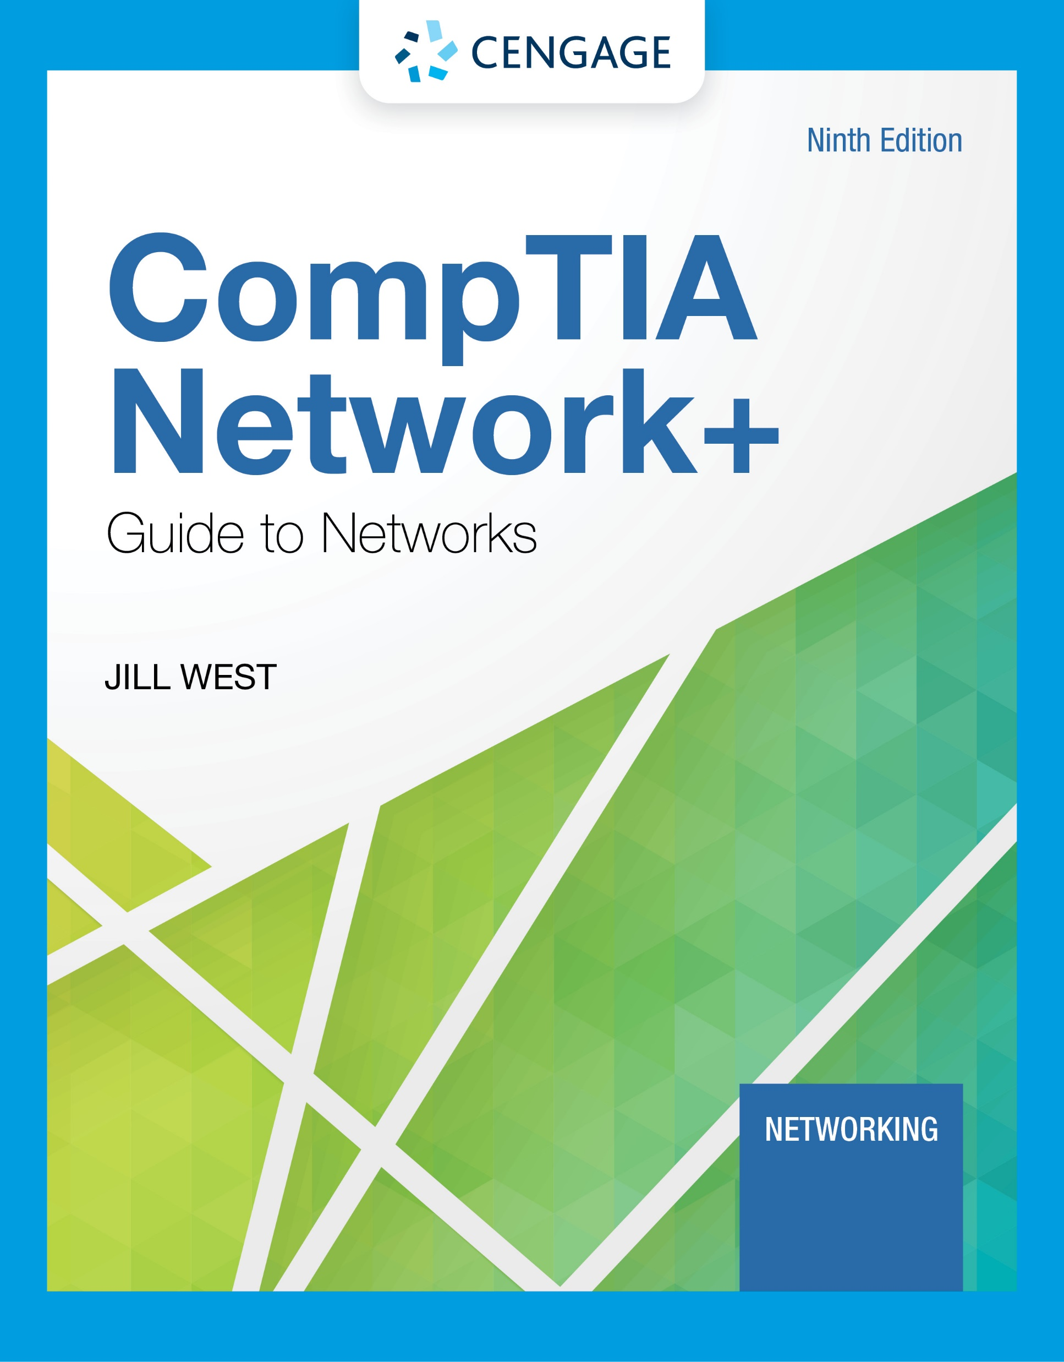
Module 1: Introduction to Networking
CompTIA Network+ Guide to Networks, Ninth Edition

Slide 2
Module Objectives
By the end of this module, you should be able to:
1. Distinguish between peer-to-peer and client-server networks
2. Identify types of applications and protocols used on a network
3. Describe various networking hardware devices and the most common physical topologies
4. Describe the seven layers of the OSI model
5. Explain best practices for safety when working with networks and computers
6. Describe the seven-step troubleshooting model for troubleshooting network problems

Slide 3
Module 2: Infrastructure and Documentation
CompTIA Network+ Guide to Networks, Ninth Edition

Slide 4
Module Objectives
By the end of this module, you should be able to:
1. Describe the roles of various network and cabling equipment in commercial buildings and work areas
2. Maintain network documentation
3. Manage changes made to a network

Slide 5
Module 3: Addressing
CompTIA Network+ Guide to Networks, Ninth Edition

Slide 6
Module Objectives
By the end of this module, you should be able to:
1. Work with MAC addresses
2. Configure TCP/IP settings on a computer, including IP address, subnet mask, default gateway, and DNS servers
3. Identify the ports of several common network protocols
4. Describe domain names and the name resolution process
5. Use command-line tools to troubleshoot common network problems

Slide 7
Module 4: Protocols
CompTIA Network+ Guide to Networks, Ninth Edition

Slide 8
Module Objectives
By the end of this module, you should be able to:
1. Describe the functions of core TCP/IP protocols
2. Identify how each protocol’s information is formatted in a TCP/IP message
3. Secure network connections using encryption protocols
4. Configure remote access connections between devices
5. Employ various TCP/IP utilities for network discovery and troubleshooting

Slide 9
Module 5: Cabling
CompTIA Network+ Guide to Networks, Ninth Edition

Slide 10
Module Objectives
By the end of this module, you should be able to:
1. Explain basic data transmission concepts, including frequency, bandwidth, throughput, multiplexing, and common transmission flaws
2. Describe the physical characteristics of and official standards for coaxial cable, twinaxial cable, twisted-pair cable, fiber-optic cable, and their related connectors
3. Compare the benefits and limitations of various networking media
4. Select and use the appropriate tool to troubleshoot common cable problems

Slide 11
Module 6: Wireless Networking
CompTIA Network+ Guide to Networks, Ninth Edition

Slide 12
Module Objectives
By the end of this module, you should be able to:
1. Describe characteristics of wireless transmissions
2. Explain 802.11 standards and innovations
3. Plan a Wi-Fi network
4. Secure a Wi-Fi network
5. Troubleshoot a Wi-Fi network

